Slide 1
Data-enabled Science: Challenges and Opportunities
2013 Tropical Cyclone Research Forum
67th Interdepartmental Hurricane Conference
6 March 2013
College Park, MD
Dr. Mohan Ramamurthy
Unidata Program Center
University Corporation for Atmospheric Research

Slide 2
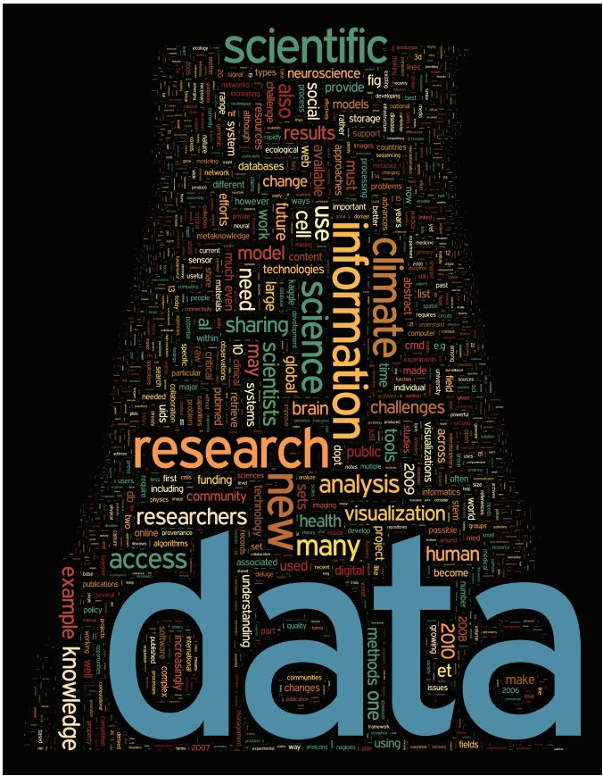
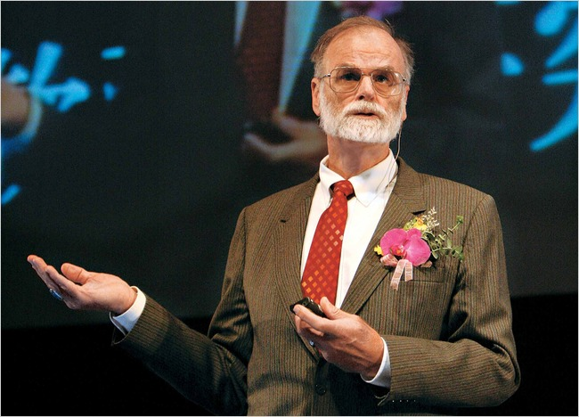
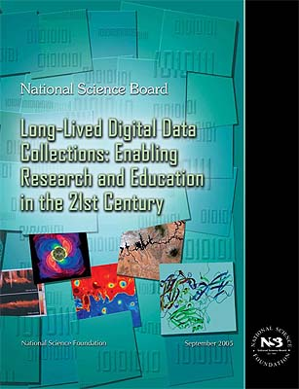
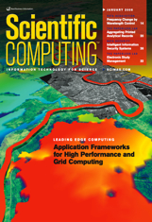
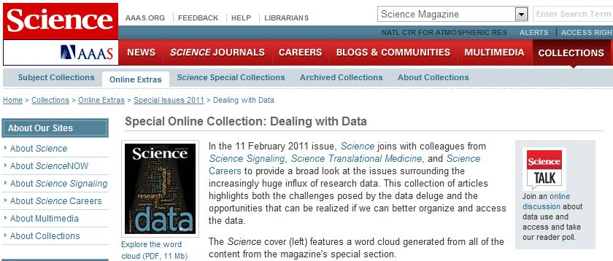
The Era of Data-Intensive Science
Data is the lifeblood of science, but we need to move from creating data to discovering knowledge.

Slide 3
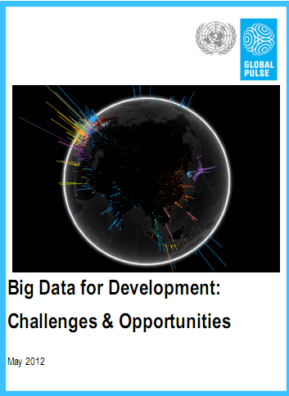
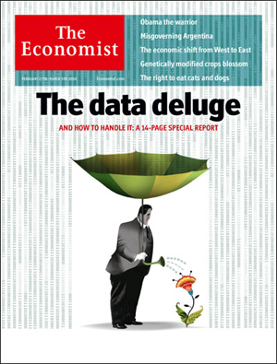
BIG DATA BUZZ

Slide 4
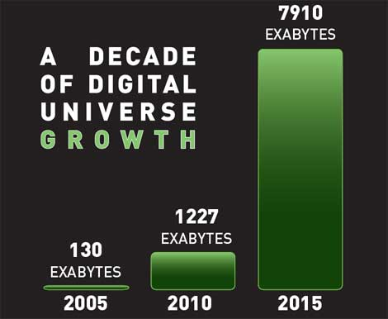
Digital Universe
According to a study by IDC, 1.8 Zettabytes of information was created in 2011.
The Internet of things.

Slide 5
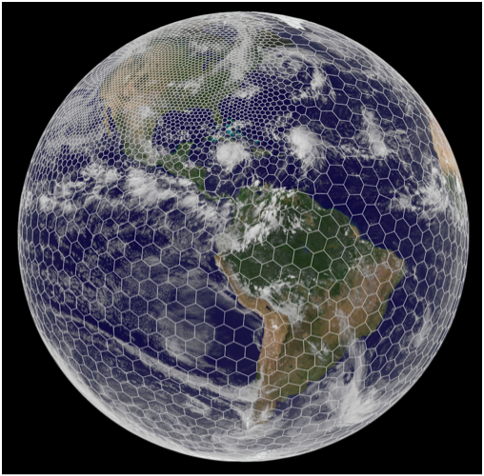
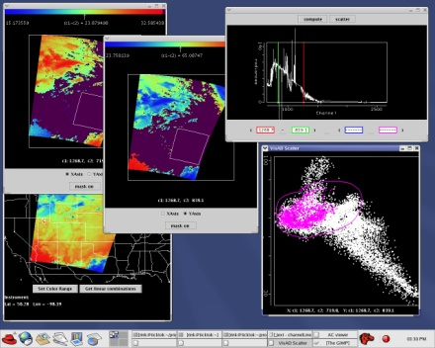
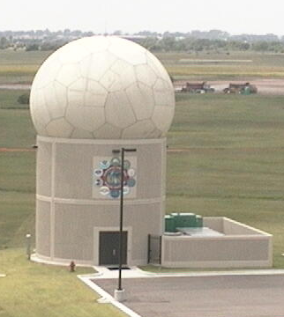
“Sea of Data”
GOES-R (2017)
JPSS (2014)
~3 Tb of data/day
Phased Array Radar, with 20 to 30-second volume scans, compared with 5-7 mins. with current radars.
Global, high-resolution coupled models integrated in ensemble mode from days to decades

Slide 6
CMIP-5 & IPCC Fifth Assessment
Source: Bryan Lawrence, British Atmospheric Data Centre

Slide 7
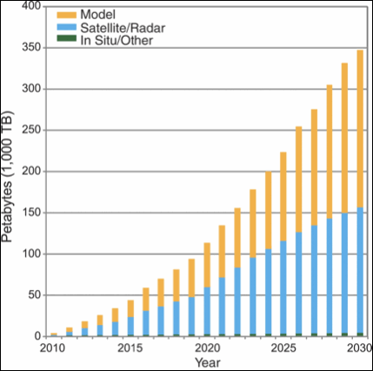
Expected Increase in Data Volume
Source: NCDC, NOAA

Slide 8
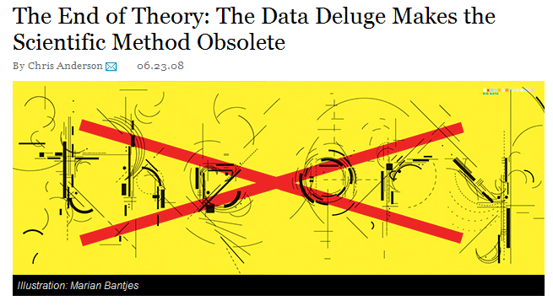
A Provocative Suggestion
Wired, 23 June 2008 issue

Slide 9
Data Challenges: The Five “V”s
Volume: Explosion of data
Variety: Different types of data (e.g, multidisciplinary, societal information, etc.); interoperability
Velocity: Rate of change, Speed of discovery, access, analysis, integration, and visualization;
Views: Many consumers of data (e.g., researchers, educators, policy makers, social scientists, and the public); Diverse applications; Multiple devices;
Virtual Communities: Globally distributed, different practices and policies for data sharing;

Slide 10
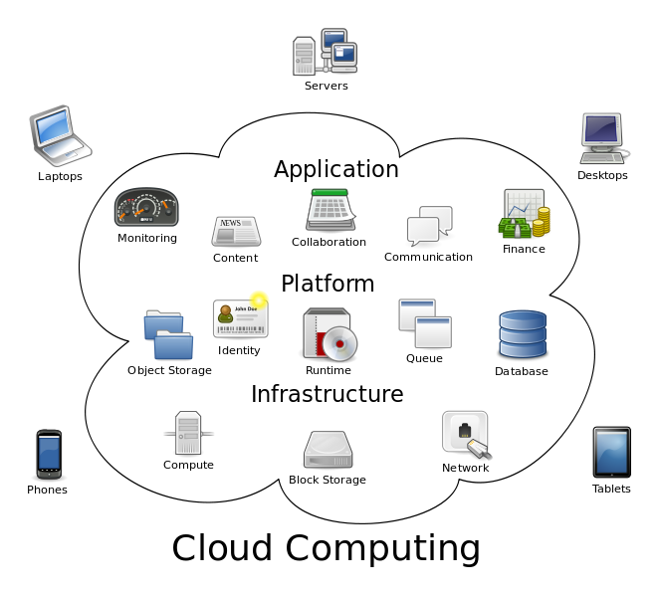
Services in a Cloud Client Access from any Device
Many types of data services running in the cloud
A range of client devices

Slide 11
“Cloud” Computing & Virtualization
Data volumes are too large to bring all of the data to your local environment
Need to keep data close to the point of origin or dissemination
Will need to move more of the processing, applications, and computations on to the server (e.g., GDS, NCO, etc.).
Impractical to store/serve data in multiple formats – so need built-in translators, brokers and mediation services.
Industry is well ahead of the science community in dealing with Big Data, Cloud Computing, and Virtualization (e.g., SaaS, Application Service Providers, MapReduce, Hadoop)

Slide 12
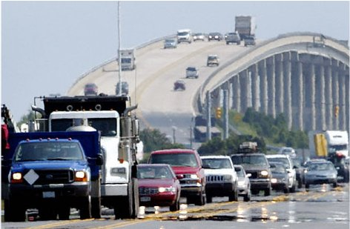
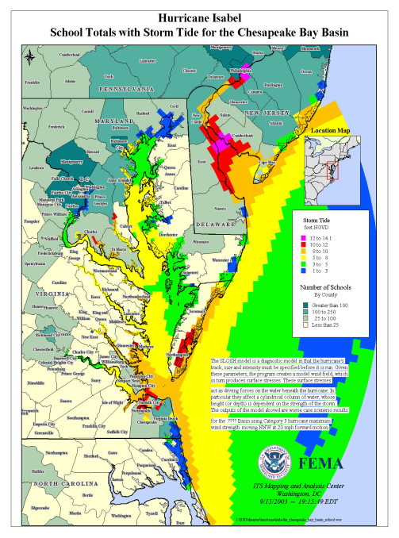
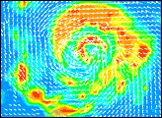
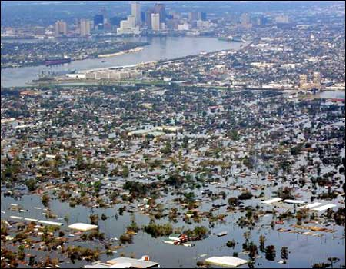
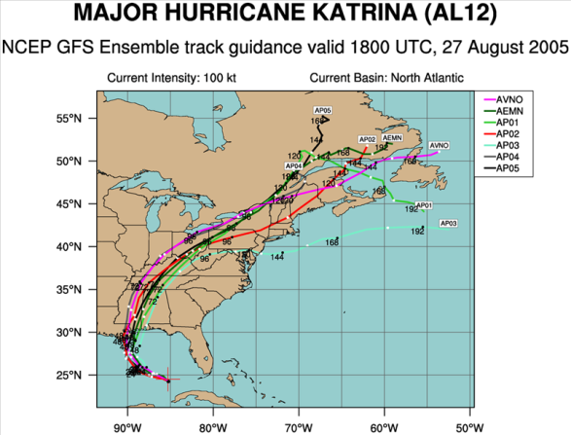
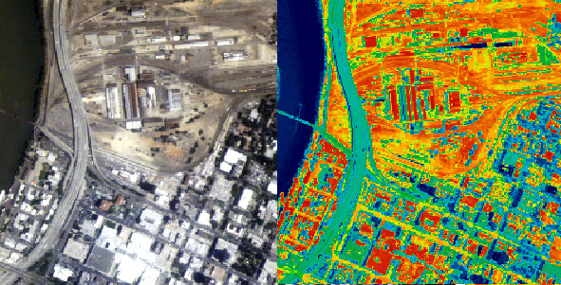
End-to-End Data Services Chained by Workflows
GIS Integration
Ensemble
Predictions
Emergency Response
Coastal Environments
Predicting societal impact of flooding from hurricanes involves integrating data from atmospheric sciences, oceanography, hydrology, geology, and social sciences and interfacing the results with decision support systems.

Slide 13
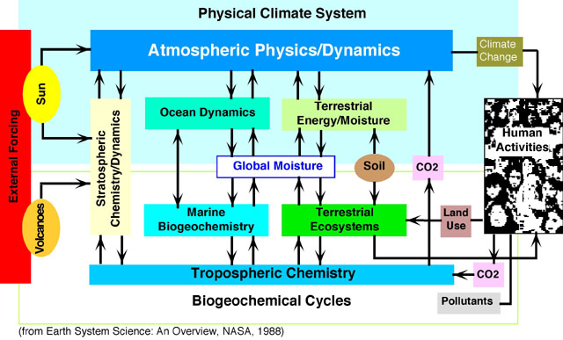
Earth System/Multidisciplinary Science
It requires data and information integration and knowledge synthesis across “systems” or domains.
Challenge: Providing the right data, in the right format, to the right application.

Slide 14
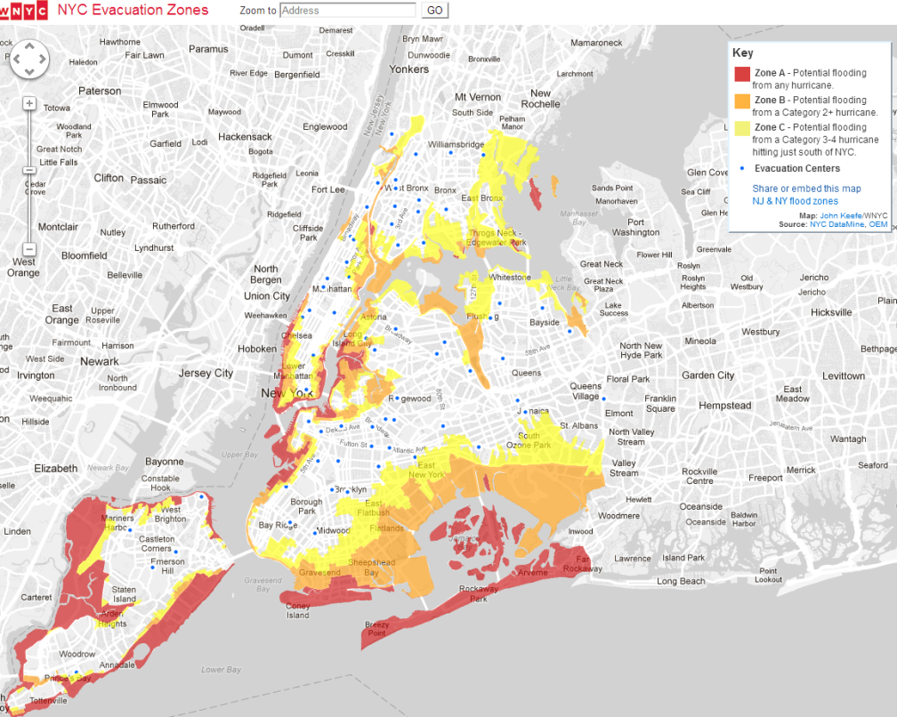
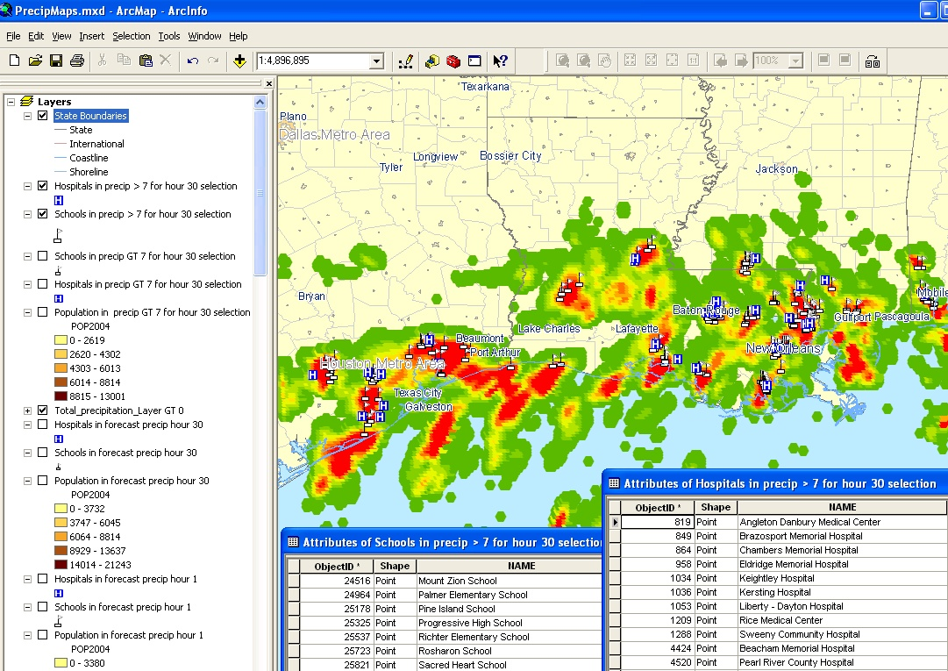
GIS Integration: An Enormous Opportunity
Need geospatially-enabled cyberinfrastructure so that information can be integrated for location-based understanding of events, processes, interactions, and impacts.
GIS integration should not be an after thought. Scientific data systems need to directly enable GIS tools.

Slide 15
The Long Tail Problem
NSF Guideline: All proposals must include a Data Management Plan.
By some estimates, only 5% of the data generated by individual PIs is shared
There are many reasons for this – both sociological as well as technical
Lack of incentives
Inadequate resources; burden of unfunded madate
Protectiveness – PIs don’t want to be “scooped”
Absence of campus or community data repositories
Need to give PIs the tools and incentives for sharing their data and adding metadata
Need to change the culture

Slide 16
Data Citation: Opportunity & Challenge
Scientific publications should be accompanied by data, algorithms, models, and parameters – need comprehensive data citation. Need transparency. Important for reproducibility.
This is not just a technical challenge, but it is also a major cultural and organizational challenge.
New way of thinking for authors, software developers, data providers, publishers, and other stakeholders
Incentives for authors and publishers
Copyright and intellectual property right issues
Persistence of all components: datasets, tools, processing services, and interfaces

Slide 17
Unidata 2020
Vision: Geoscience at the Speed of Thought through accelerated data discovery, access, analysis, and visualization.
Reduce “data friction”, lower the barriers, and reduce “time to research”
Accelerate user workflows (manual or automated)
Contribute toward flipping the 4:1 ratio (the current 80-20 situation)

Slide 18
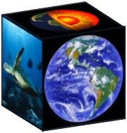
EarthCube Vision
• Transform the conduct of geosciences research with the next generation CI .
• Create effective community-driven cyberinfrastructure.
• Enable global data discovery within the geosciences
• Achieve interoperability and data integration across disciplines.
Dynamic Earth
Changing Climate
Earth & Life
Geosphere-Biospheric Connection
Water: Changing Perspectives

Slide 19
EarthCube Community Workshop
Shaping the Development of EarthCube to Enable Advances in Data Assimilation and Ensemble Prediction
17-18 December 2012, Boulder CO
Recommendations
A pilot project on coordinated, distributed national ensemble prediction that involves universities that are interested in participating.
Develop a prototype system that links data sets and assimilation and prediction systems systems together, involving the most used projects.
Create a concrete plan for greater coordination of ongoing and future programs and facilities, developing a next-generation testbed facility to advance the science.
Organize meetings to leverage and expand communication, and enhance data sharing, and facilitate sustained interactions.
Entrain undergraduate and graduate students into research and educational activities related to “big data.

Slide 20
Concluding Remarks
We live in an exciting era in which advances in computing and communication technologies, coupled with a new generation of geoinformatics, are accelerating scientific research, creating new knowledge, and leading to new discoveries at an unprecedented rate.
Contact: mohan@ucar.edu
Acknowledgement: NSF Award 0833450

